Slide 1
Netflix Analysis
Joseph Damico
09/07/2024
Data Presentation & Visualization

Slide 2
Call to Action
To effectively leverage viewership data for optimizing Netflix’s content strategy and expanding global reach, it's crucial to understand viewer preferences and trends. By examining the popularity and performance of different shows across various categories and countries, Netflix can tailor its content offerings and marketing strategies to maximize engagement and satisfaction.

Slide 3
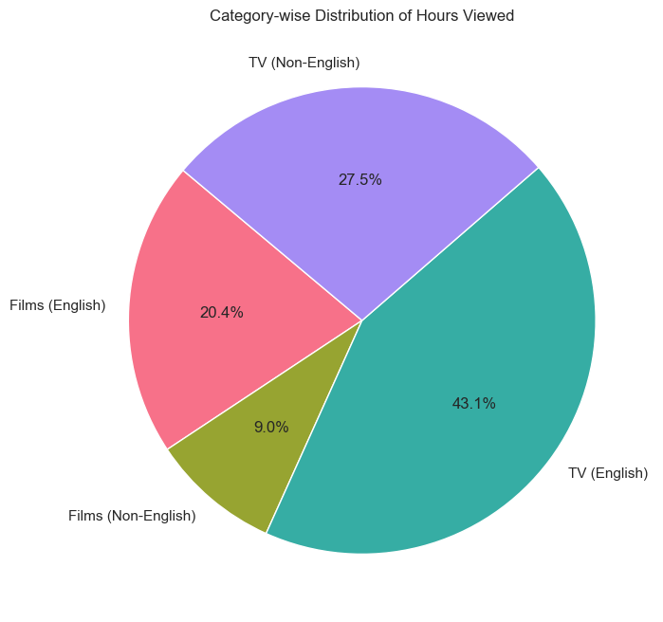
Hours viewed shows vs. films
Description: This chart illustrates the proportion of weekly hours viewed by category on Netflix.
Relation to Call to Action: By highlighting the dominant categories—TV (English) and TV (Non-English)—this visualization emphasizes the importance of diversifying content offerings. This data supports the call to action by suggesting a need to focus on popular categories to enhance viewer engagement.

Slide 4
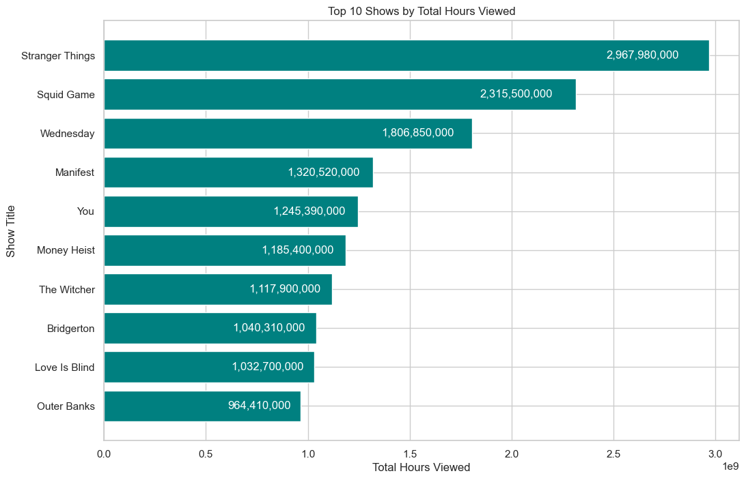
Top 10 Shows by Hours Viewed
Description: This bar chart displays the top 10 shows by total hours viewed.
Relation to Call to Action: The chart shows which shows have captured the most attention, indicating viewer preferences and trends. This insight is vital for content strategy, suggesting which genres or types of shows might be more successful if replicated or expanded.

Slide 5
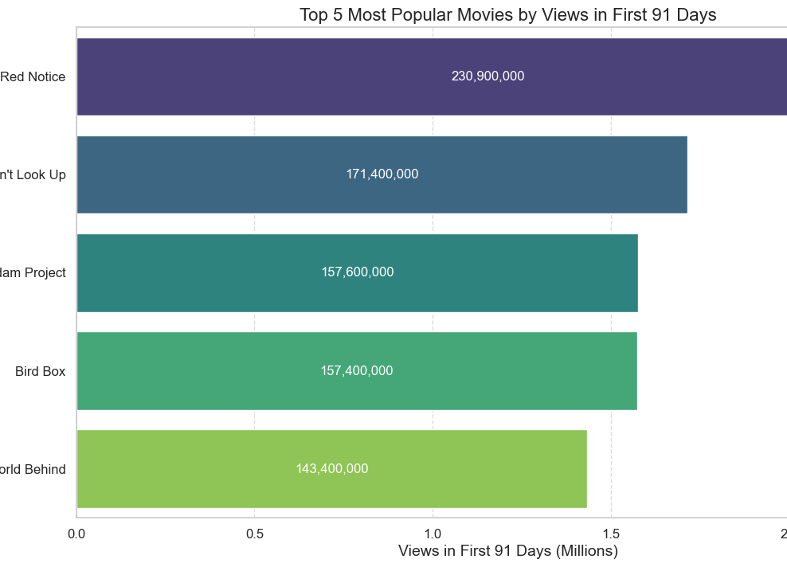
Most Popular Movies
Description: This summary lists the top 5 movies based on views in the first 91 days.
Relation to Call to Action: This data reveals which movies gained the most traction quickly. Understanding these trends helps in making data-driven decisions about future movie productions and marketing strategies.

Slide 6
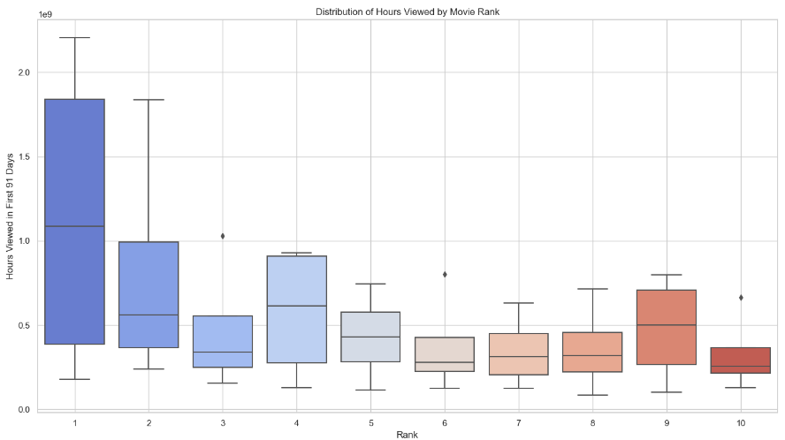
Hours by Movie Rank
Description: This Box Plot lists the hour watched for movies depending on current rank.
Relation to Call to Action: This data reveals how movie rankings affect longevity of the movie. Showing lower ranked movies as an area to cut cost for licensing or storage reasons quicker.

Slide 7
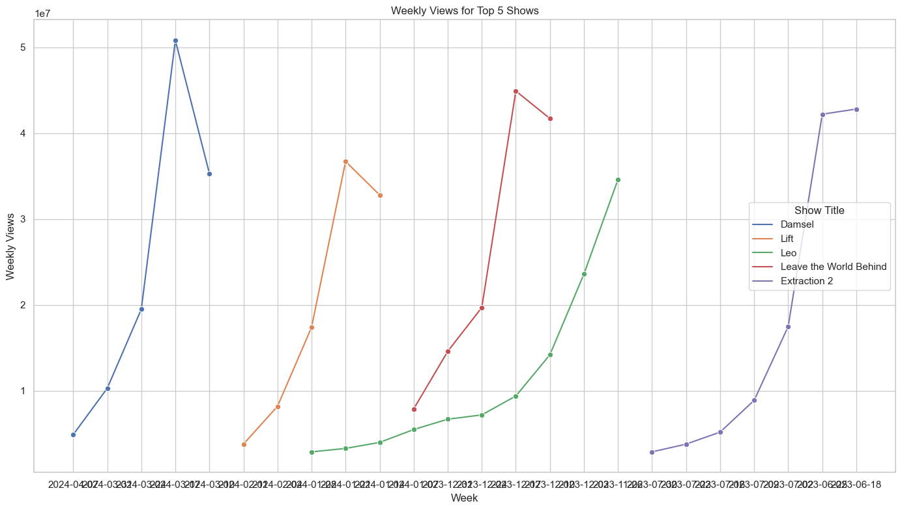
Line Chart of Weekly Views for Top 5 Shows
Description: This line chart shows the average weekly views for the top 5 shows.
Relation to Call to Action: By identifying which shows maintain high viewership over time, Netflix can focus on producing similar content or ensuring continuous engagement with successful shows. This helps in optimizing content based on viewer habits.

Slide 8
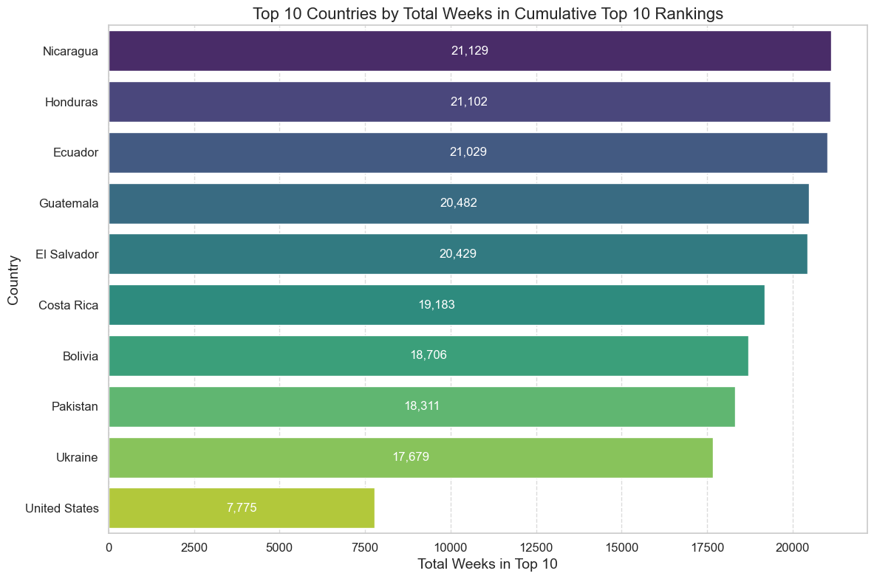
Cumulative top 9 rankings
Description: This chart highlights the top 9 countries by cumulative weeks in the Netflix Top 10, with the USA included.
Relation to Call to Action: Identifying the countries with the most consistent top 10 performances can guide Netflix’s regional content strategies and marketing efforts. The inclusion of the USA helps in understanding its competitive position globally.

Slide 9
Summary & Recommendations
The data highlights that TV shows, especially in English, dominate Netflix viewership. Top titles like Stranger Things and Squid Game show significant engagement. The line chart reveals high average weekly views for certain shows, while popular movies like Red Notice also perform well. Notably, viewership is strong in specific countries. To capitalize on these insights, focus on promoting successful content categories and tailored regional strategies.
To optimize content strategy and drive global engagement, leverage these insights to tailor Netflix’s offerings and marketing efforts. Prioritize high-performing content categories and regions to maximize viewer satisfaction and growth.

